Slide 1
Improving Student Access and Engagement in STEM Education The Impact of Prolonged Mentorship and Participatory Design in Both High School and College Settings
Panelists: Prof. Lynn Cominsky, Robin Dubois, Xander Starling (Sonoma State U)
Prof. Josephine Blagrave, Matthew Borrelli (CSU Chico)
Jason Kim-Tong (CSU East Bay)
Sam Tumolo (EDC)
Jordan O’Kelley (West Virginia University)
With additional support from: Ariana Arista, Shubha Kashinath, Grace Harrison, Chloe Contestable, Sonia Quintero, Shannon McEntee, Susannah Lanter, Christopher Bell, Gabriel Tsuruta, Sofia Rubio, Avi Taneja, Jefferson Ly and Betina Wildhaber

Slide 2
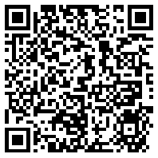
Presentation Slides and Handouts

Slide 3
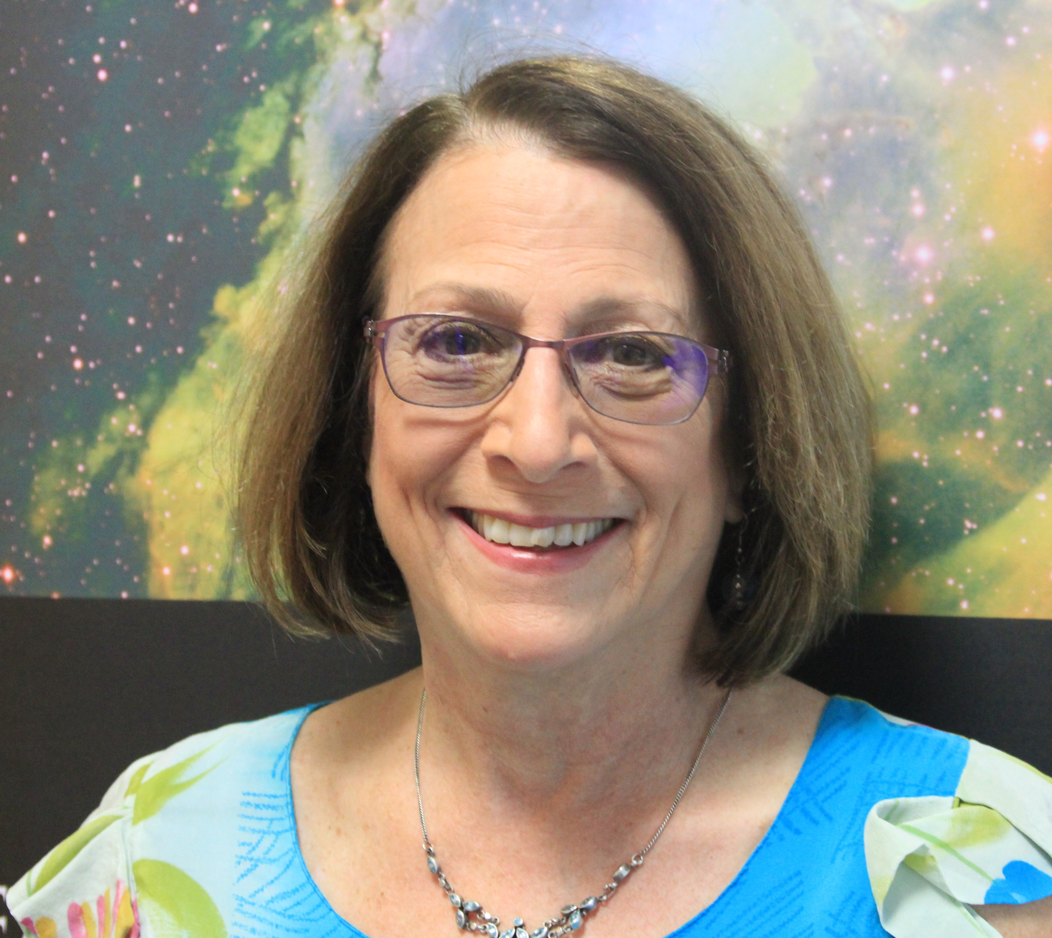
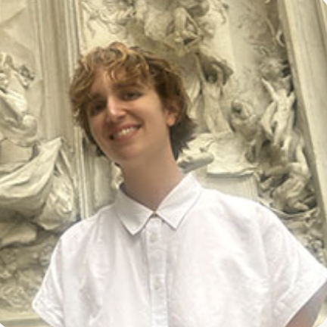
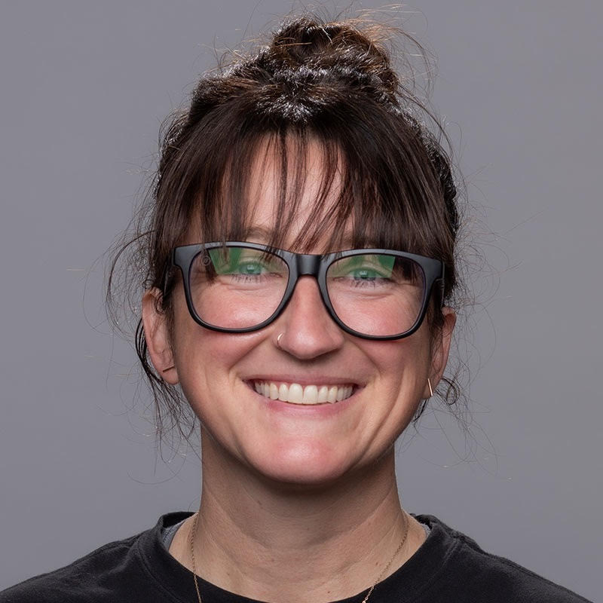
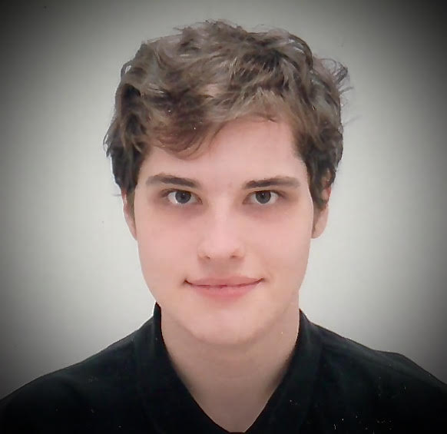
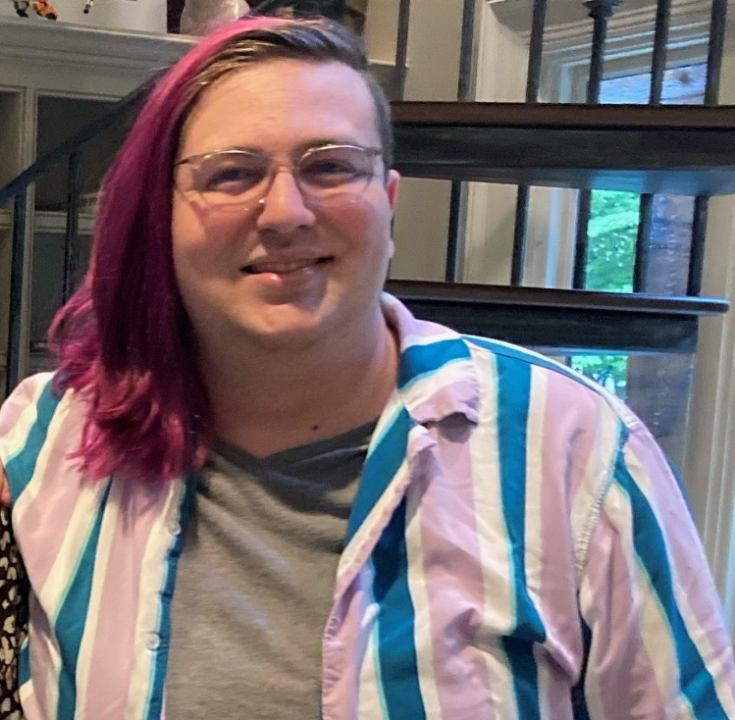
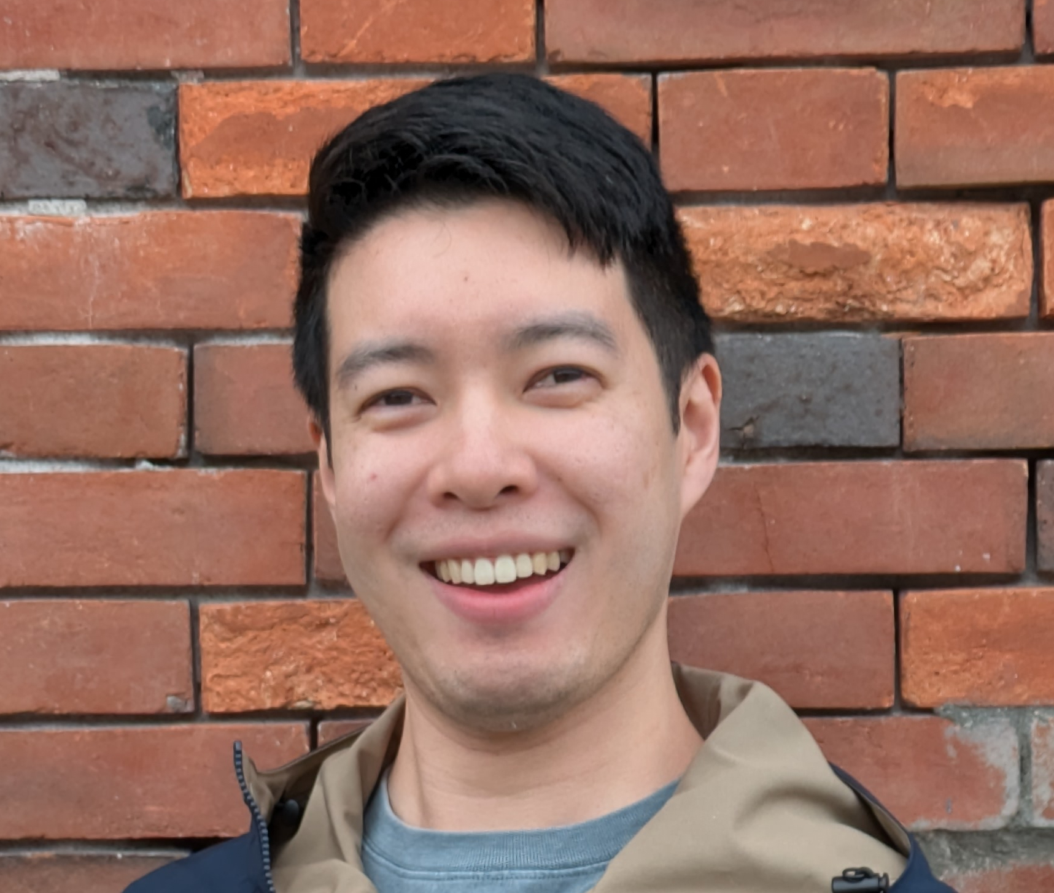
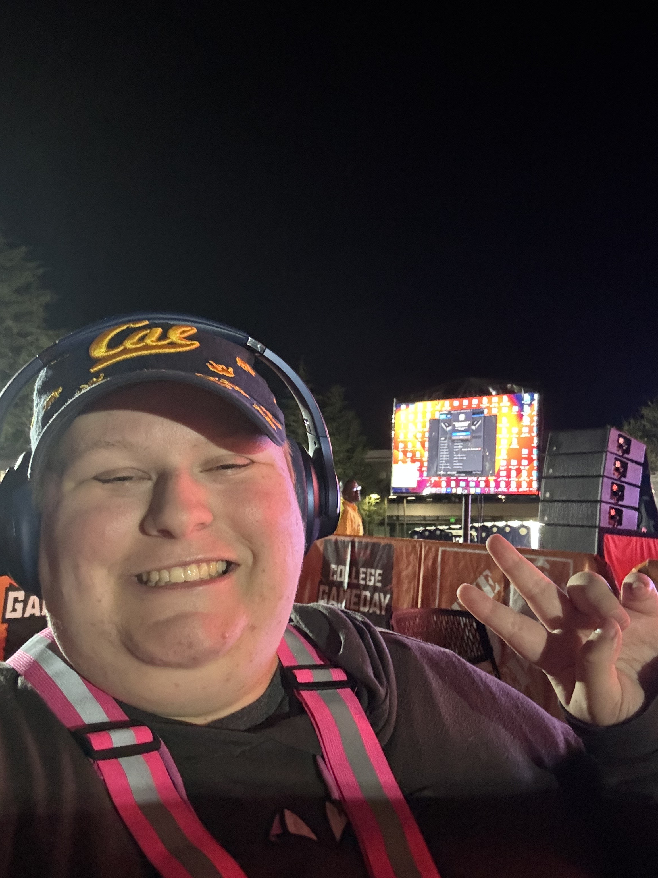
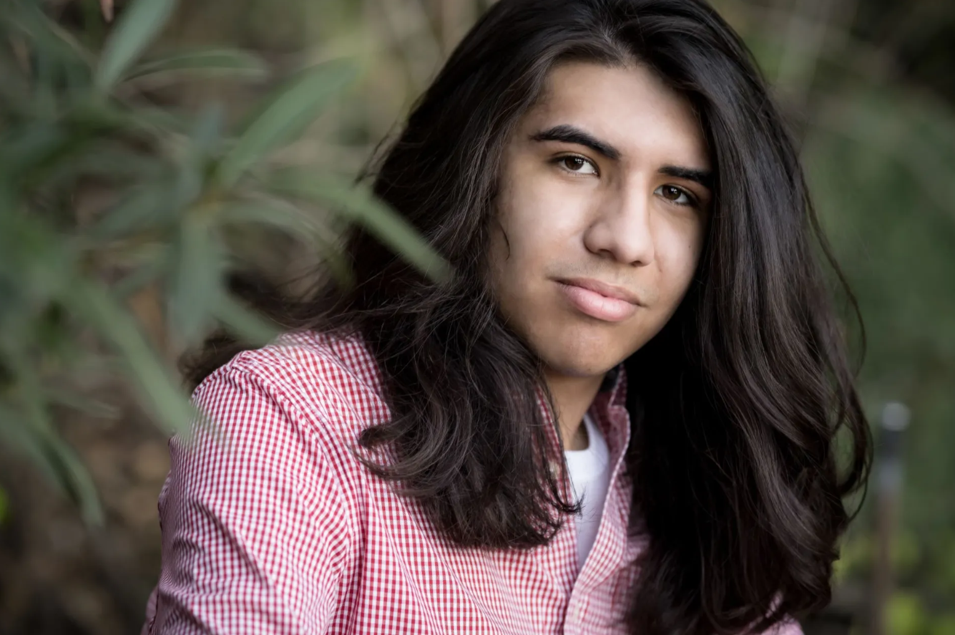
Today’s speakers
Prof. Lynn Cominsky (SSU)
Sam Tumolo (EDC)
Prof. Josephine Blagrave (CSU Chico)
Jordan O’Kelley (WVU)
Jason Kim-Tong (CSU East Bay)
Matthew Borelli (CSU Chico)
Jason Kim-Tong (CSU East Bay)
Robin Dubois (SSU)
Xander Starling (SSU)

Slide 4
Today’s Agenda
Introduction to our Programs (Lynn Cominsky, SSU)
NASA’s Neurodiversity Network (N3)
N3 Highlights and Challenges
Sam Tumolo (EDC)
Jordan O’Kelley (WVU)
Engaging Autistic STEM Undergraduates in Creating Supportive Learning Environments at California State Universities (NU)
NU Highlights and Challenges
Robin Dubois and Xander Starling (SSU)
Matthew Borelli (CSU Chico)
Jason Kim-Tong (CSU East Bay)
Audience Workshop (Prof. Josephine Blagrave, Chico)
Resources for your campus
Q&A

Slide 5
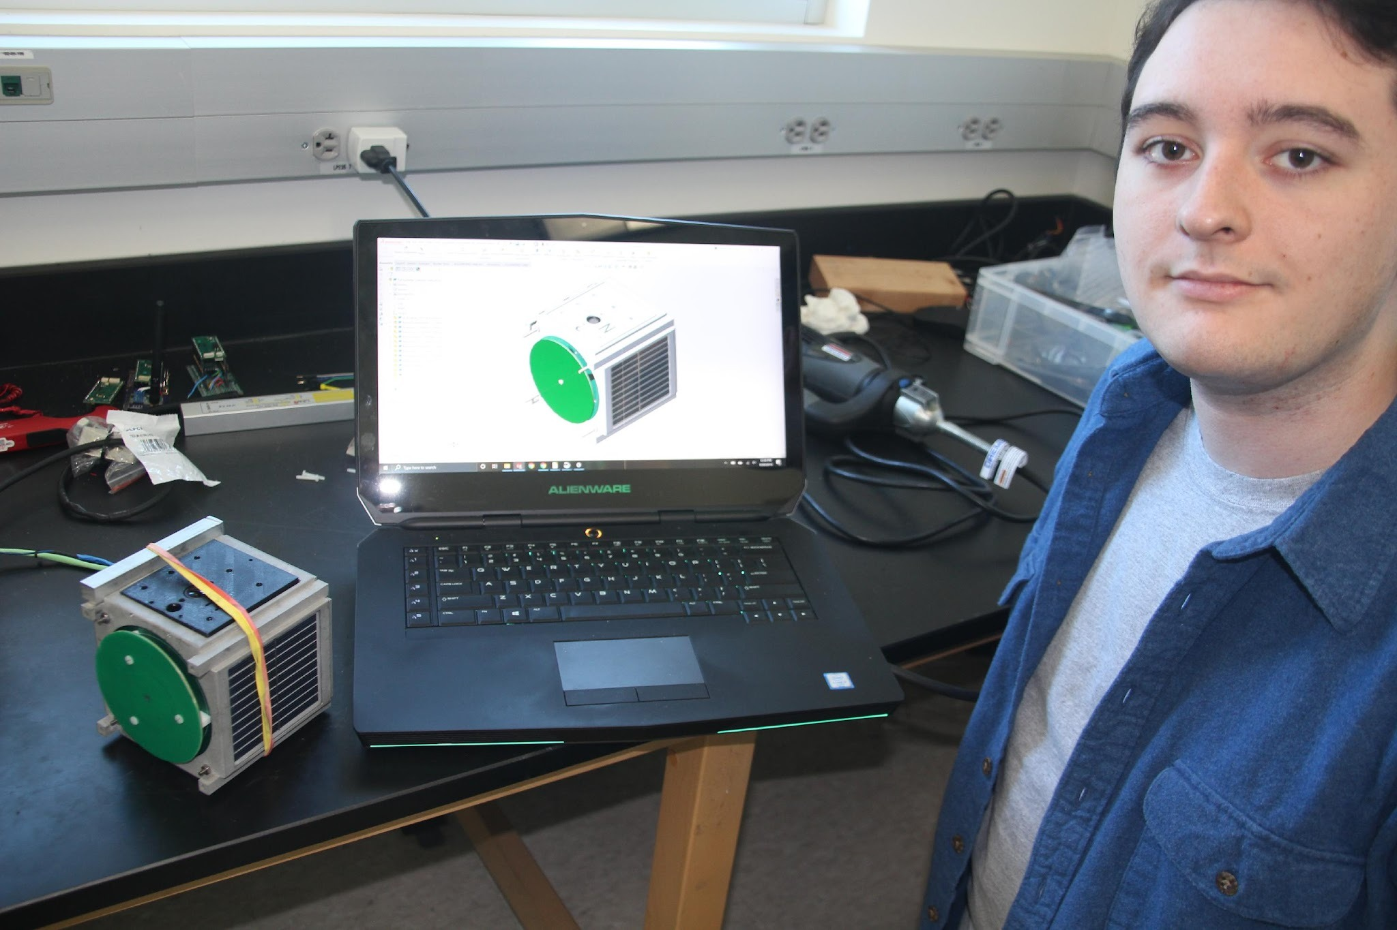
N3 Inspiration: Alex’s Story
Alex began volunteering at SSU when he was 18 and enrolled in local community college
Transferred to SSU as physics major and was SSU’s first CalBridge scholar
Alex contributed to a number of research projects and completed two competitive summer REUs. He is now the recipient of an NSF GFRP in physics graduate school at UC Irvine.
During his time at SSU, Prof. Cominsky put in intensive time and effort to mentor Alex and ensure he had what he needed to succeed:
Paperwork and advocacy support, discussion of milestones, supportive social network within the Cominsky lab, continued long-term mentoring
Alex’s senior project – EdgeCube CAD design

Slide 6
NASA’s Neurodiversity Network
Program goals: Provide a pathway to NASA participation and STEM employment for neurodiverse learners, with a focus on those who identify as autistic.
Enabling STEM education for a segment of the population that is significantly underserved by co-redeveloping existing NASA resources with autistic learners.
Improving scientific literacy for this underserved population by providing authentic NASA experiences
Providing internships, mentored by NASA Subject Matter Experts, to selected neurodiverse learners.

Slide 7
Internship Program Details
93 interns participated in virtual research projects spanning NASA science.
All interns are paired with a Subject Matter Expert (SME) from NASA’s Science Mission Directorate with expertise in at least one of the following areas: Astrobiology, Astrophysics, Earth and Environmental Science, Heliophysics and Planetary science, Space Instrumentation.
Summer interns complete at least 150 hours (~one month of full-time work) between June 1 and August 15. Mentors meet with interns weekly.
Mentors are trained each year, and provided support throughout the summer.
Interns are paid a $1,000 stipend and mentors are paid a $2,000 stipend.
https://n3.sonoma.edu/internship/about/

Slide 8
Program features and Lessons learned
PROGRAM FEATURES:
Weekly Summer Meetings: Current intern cohorts meet weekly during the summer for scientific, socio-emotional and college application support.
Monthly Scholars Meetings: All year, monthly meetings for the entire N3 community include science talks and executive functioning support. Students who weren’t accepted to the internship program are invited to attend and build experience.
Mentor Trainings: Mentors are trained each year on working with neurodiverse students; we now have experienced mentors who share best practices.
Post-Internship Professional Development: Many interns continue to work on their projects after the summer has ended. 6 Interns have presented at professional conferences to date and 2 are now co-authors on peer-reviewed journal articles.
BEST PRACTICES:
Create Opportunities For Socialization: Interns wanted more opportunities to socialize → Discord channel, gaming
Include Parents: Invite parents initial on boarding meeting – most interns are minors
Host Practice Sessions: To help interns feel confident and prepared for the final presentation
Consistently Seek Input: Collect input from interns regarding program logistics, topics they want to learn more about, and areas in which they need additional support

Slide 9
N3 highlights and challenges
Highlights:
Implemented 3 inclusive space science camps at the New York Hall of Science
Published ”Astronomy at Home” and “Solar Science” curriculum for high school students (middle school coming soon)
Supported 93 autistic interns in completing research projects with NASA SME’s
Recruited 49 NASA SME’s to serve as mentors and provided training on working with autistic students
Presented at INSAR, AAS, AERA, Connected Pathways, AGU, Stanford Neurodiversity Summit, ASTC conferences
Developed “Scholars” program for autistic high school students who weren’t accepted to the internship program
Publications in Connected Science Learning and upcoming publications in ISL Co-Design book
Challenges:
Difficulty with consistent attendance for full team meetings across time zones
Participation challenges and interns keeping cameras off
Had to adapt to many interns preferring to use the chat to communicate vs. speaking aloud
Many interns struggled to keep presentations within the time allotted, so we encouraged pre-recording videos
Paperwork logistics and stipend payment processes proved challenging for interns and needs streamlining

Slide 10
Ways to connect with N3!
https://forms.gle/zYRhTJ3R6uvSPXT79
HS students: apply for the N3 internship program! Applications for 2026 will open in January 2026 (if we can raise the funding): https://n3.sonoma.edu/internship/about/
Check out Astronomy from Home Discover activities: https://afh.sonoma.edu
Check out Solar Science for high school students (middle school coming soon!): https://n3.sonoma.edu/curriculum/solar/highschool/
Watch our videos: https://n3.sonoma.edu/media/videos-and-talks/
Read our peer-reviewed paper about the Codesign process: https://www.tandfonline.com/doi/full/10.1080/24758779.2024.2352775

Slide 11
Engaging Autistic STEM Undergraduates in Creating Supportive Learning Environments at California State Universities
Partner campuses include Sonoma State University, CSU Chico and CSU East Bay. (All part of the California State University system.)
Program goals: understand the needs of autistic STEM undergraduates and pilot new campus programs to improve student engagement and success.
understand the existing support landscape for autistic STEM undergraduates at three partner CSU campuses
Identify gaps in available CSU campus programs from the perspective of autistic students, faculty, staff, and administrators and make recommendations to fill these gaps
iteratively develop, implement, and evaluate pilot campus programs and experiences for autistic STEM students and professional development for faculty and staff
prepare to expand campus partnerships to additional universities by synthesizing recommendations based on findings from pilot program implementation.

Slide 12
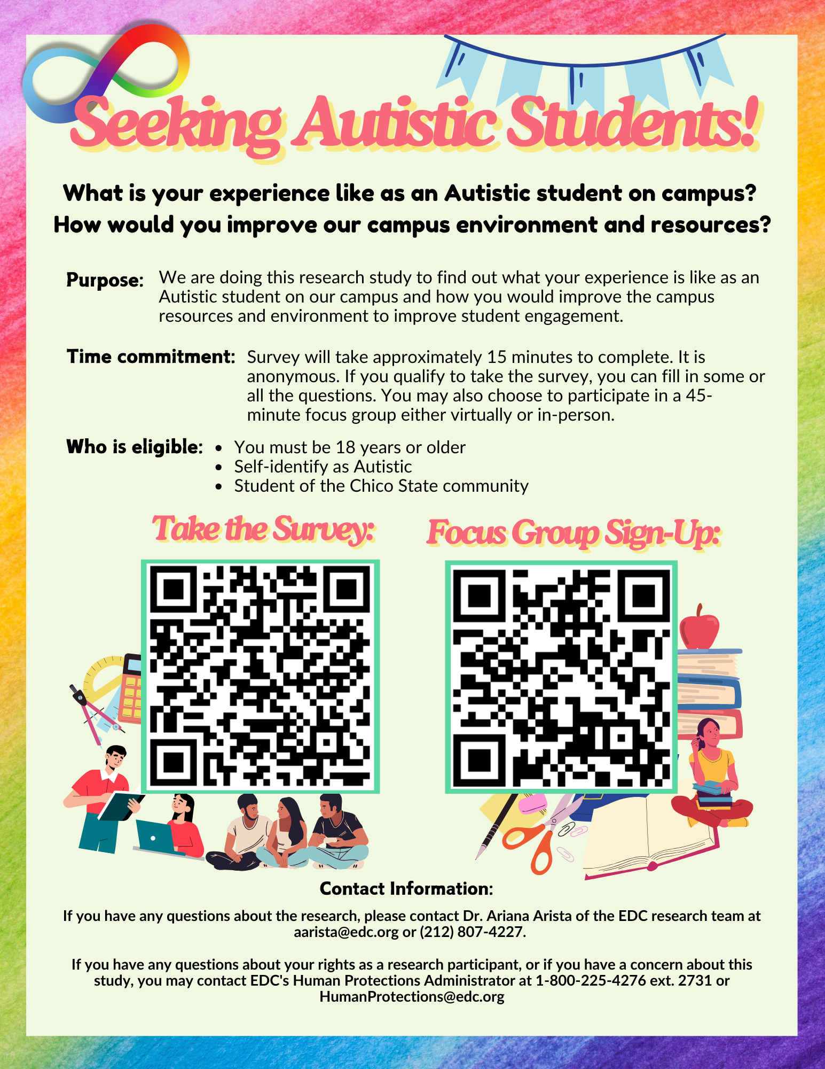
Engaging Autistic STEM Undergraduates in Creating Supportive Learning Environments at California State Universities
Research: Student Community Survey and Focus Groups
All campuses worked together to co-design an online survey for autistic students.
Goal of the survey:
Assess what students are already accessing on campus
Understand if students feel supported by faculty, staff, and fellow students in completing their degrees.
Gather ideas for campus improvement programs and activities
Goal of focus groups:
Gather additional details from students about the types of activities and supports they’d like to build on campus

Slide 13
Survey and focus group results
Students at all 3 campuses agree:
They would like to see changes to facilities and environmental factors:
fluorescent lights, lack of windows, loud hallways and gathering spaces, lack of comfortable and quiet spaces to hang out or study
there was an overwhelming number of responses asking for sensory-friendly campus spaces
Students would like more personalized accommodations:
Some students shared that their “canned” accommodations didn’t really help them succeed and working directly with professors was much more effective.
Some were unsure of what their school could offer them
Expressed that due dates, certain assignment types, and ambiguous instructions/rules in class made courses more challenging
Students expressed fatigue around having to seek out and fight for many accommodations themselves.
Students sometimes experienced stigma when asking for some accommodations and called for training and increased awareness about autism for faculty and staff.

Slide 14

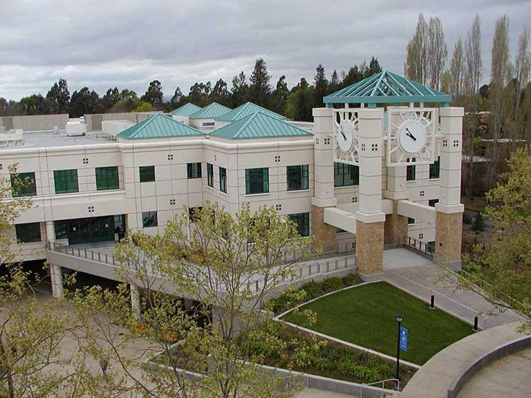
Presenter introductions:
Robin Dubois (they/it)
Psychology, graduated May 2025
Xander Starling (he/him)
Masters student in Cultural Heritage Resource Management
Characteristics of SSU
5,784 students (89.7% Undergraduate)
Existing resources for ND students:
Disability Services for Students (DSS)
Faculty support through CTET
The Hub
Counseling and Psychological Services (CAPS)
Schulz Information Center, home to EdEon, DSS, The Hub, and other services.
Notes:
Robin does this slide

Slide 15
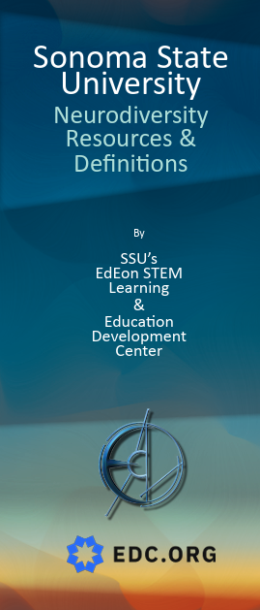
Highlights:
Established Neurodiversity club (Thanks CAS 2024/Emory University!)
Wrote Guidebook for faculty, staff and students (Thanks CAS 2024/Berklee School of Music!)
Wrote trifold brochure for tabling and recruiting events
Gave one-hour training session for allies on working with neurodivergent students via zoom sponsored by Center for Teaching and Educational Technology
Website to disseminate these materials is in progress at: https://edeon.sonoma.edu/nu/downloads/
Challenges:
It was difficult to get students to come to ND club meetings until Fall 2025 – and now we are still trying to find club leadership
We are still working on trying to get a low sensory room on campus – perhaps in the Library?
Difficulties getting faculty involved in ND club and to attend the ally training
NU website still in development
Notes:
Xander does this slide

Slide 16

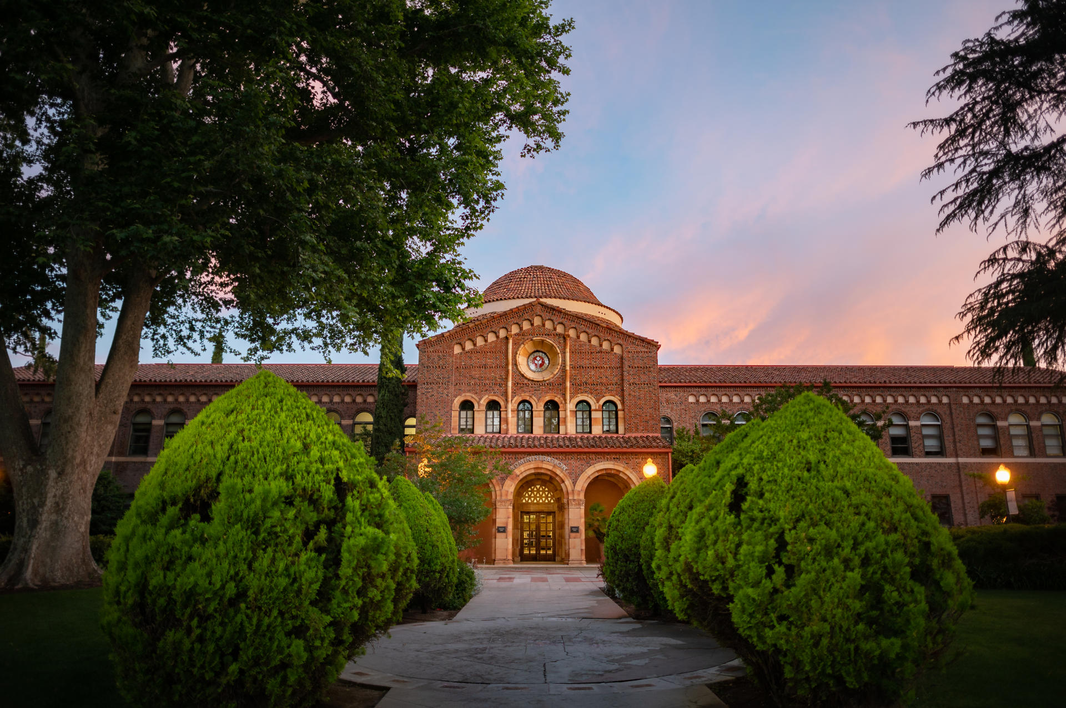
Campus partner and Student presenter introduction
Matthew Borelli (he/him)
Computer Animation major (second year)
Characteristics of Chico State
14,415 students (undergraduate: 13,635; grad: 780)
90% of students live within 1 mi of campus
Existing resources for ND students:
Autism Clinic
Accessibility Resource Center (ARC)
Neurodiversity & Disability Club (student run)
Neurodiversity & Disability Faculty Staff Association
Neurodivergence Support Group (WellCat Counseling)
Neurodiversity & Disability Symposium
Notes:
Matthew starts here

Slide 17
Highlights:
Collaborations with the Neurodiversity and Disability Faculty and Staff Association, Accessibility Resource Center, Neurodiversity & Disability Student Club
Advisor Training for College of Engineering, Computer Science and Construction Management
Advisor Training for College of Communication and Education
Over 150 Faculty and Staff Trained through Neurodiversity and Disability Ally Training (in person and virtual)
Neurodiversity & Disability Student Welcome Event
Recognition by John Marble in Neurodiversity for Dummies from our efforts
New partnerships with regional community colleges and building pipelines
Neurodiversity & Disability Think Tank
We’ve experienced very high participation and buy-in on campus: Chico has been committed to these efforts, and our project is helping with inclusivity, data collection, and future directions with our participatory team
Challenges:
Research efforts and more actionable plans take time!
Funding
Faculty Burnout

Slide 18

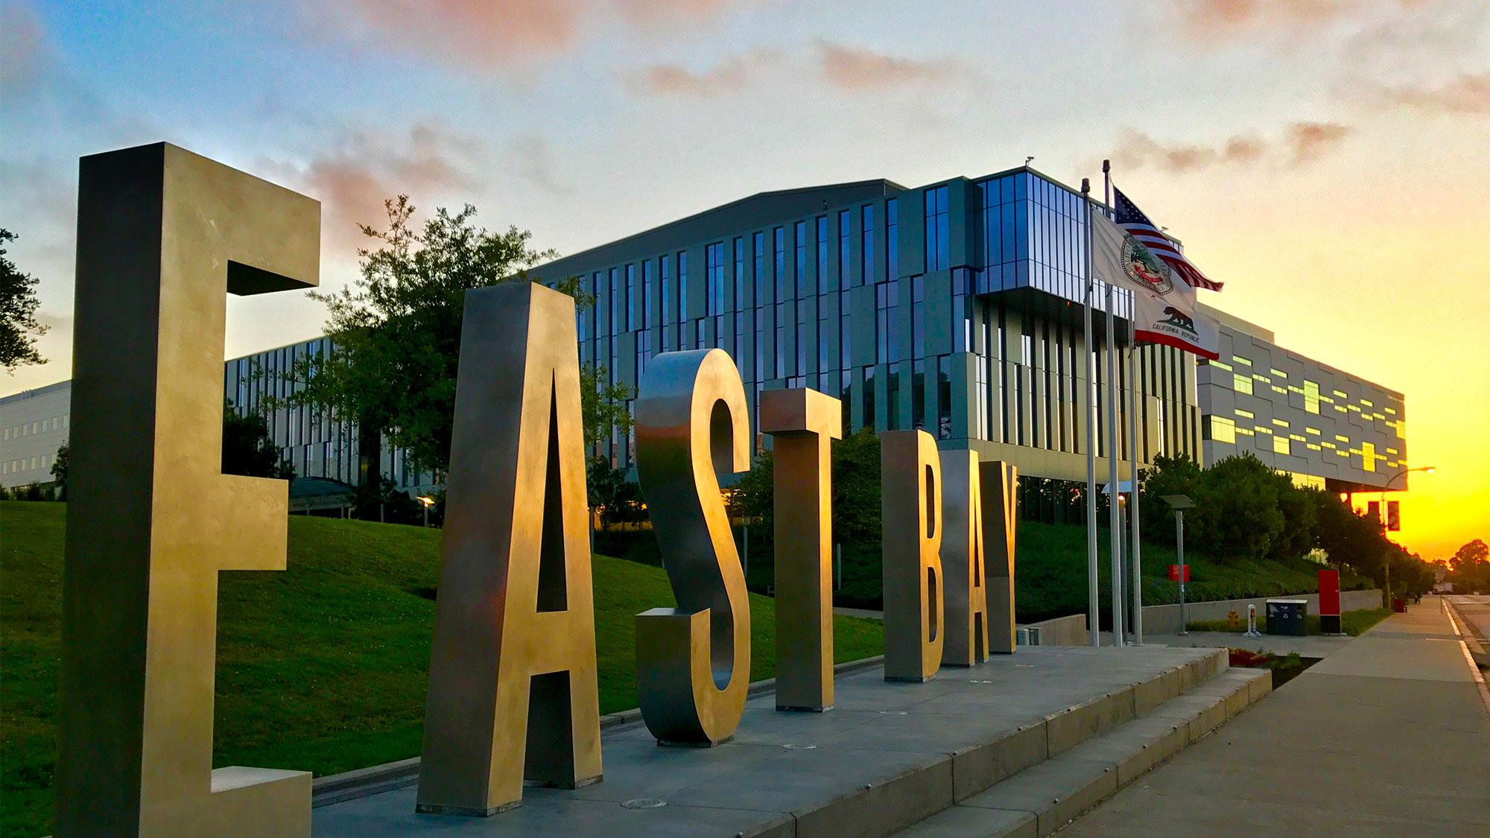
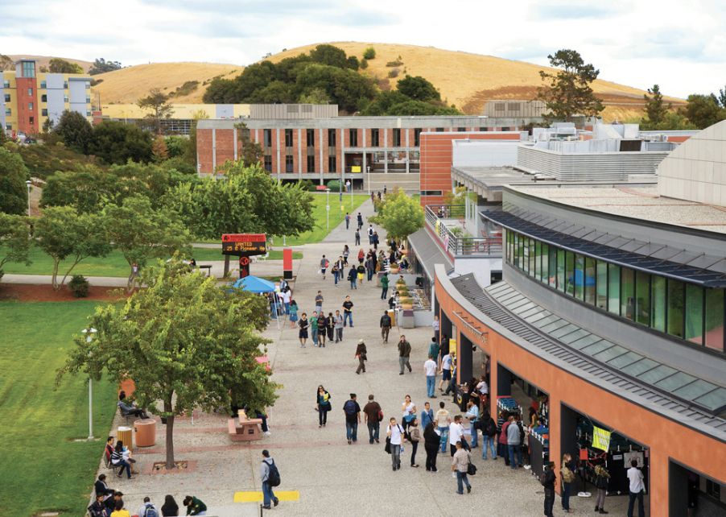
Campus partner and Student presenter introductions:
Jason Kim-Tong (he/they)
Graduate student, Speech-language pathology
Professor Shubha Kashinath (Interim Associate Dean, College of Health)
Characteristics of CSUEB
~12,000 students (~2,500 graduate)
Existing resources for ND students
Clinical programs (counseling, speech therapy)
Accessibility Services
College Link Program-a fee-based program that supports autistic students in academic, social, independent living, and employment skills.
Disability Community Collective
Center for Disability Justice Research (CDJR)
Creativity Lab-hosted by faculty in the theatre department.
Notes:
Jason starts here

Slide 19
Highlights:
High participation in our on-campus survey from faculty, staff, and peers
Islands of strong support on campus (Inclusive performance through Creativity Lab, Center for Disability Justice Research (CDJR), College Link Program (CLP)
Administrator commitment in College of Science to support ND students in STEM
Established connections with Office of Faculty Development, who hosts open office hours for faculty interested in creating inclusive syllabi
Created a student led Disability Justice and Neurodiversity Club to promote community and networking for ND students
Increased focus on supporting ND with establishment of CDJR and Think By The Bay (federally funded program for students with I/DD)
Challenges :
Lack of funding to create sustainable programming
Lack of supports for ND students on campus who are not part of CLP
Need for systematic faculty ally training.
Need for consistent and ongoing staff/advisor training

Slide 20
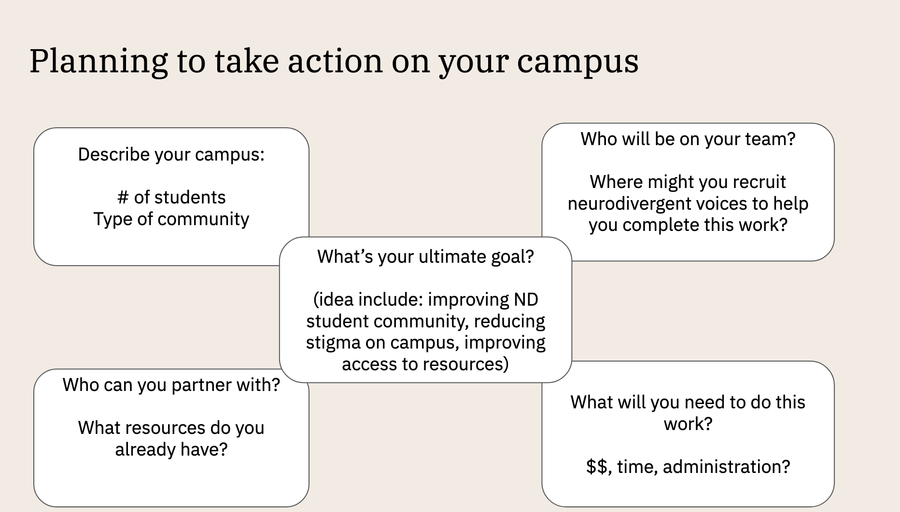
Campus Action Plans!
Notes:
Josephine starts here

Slide 21
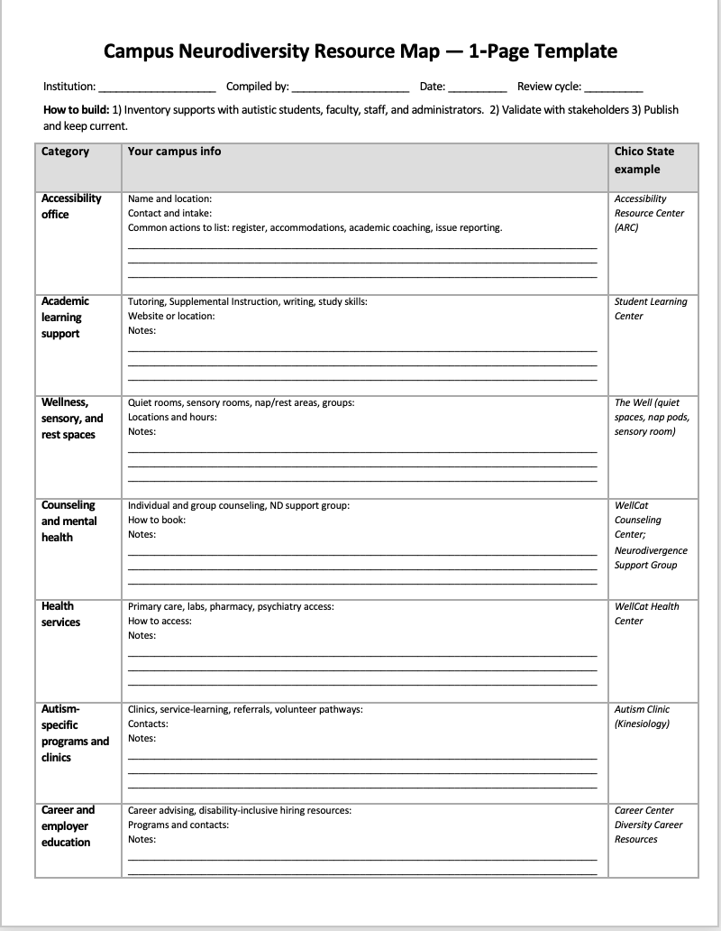
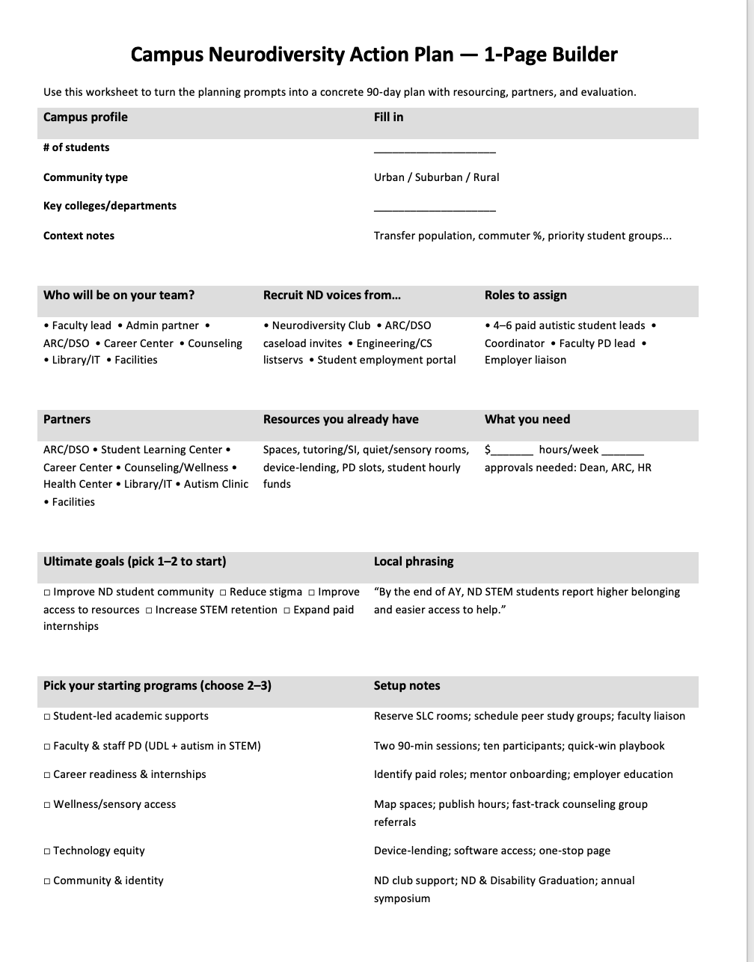
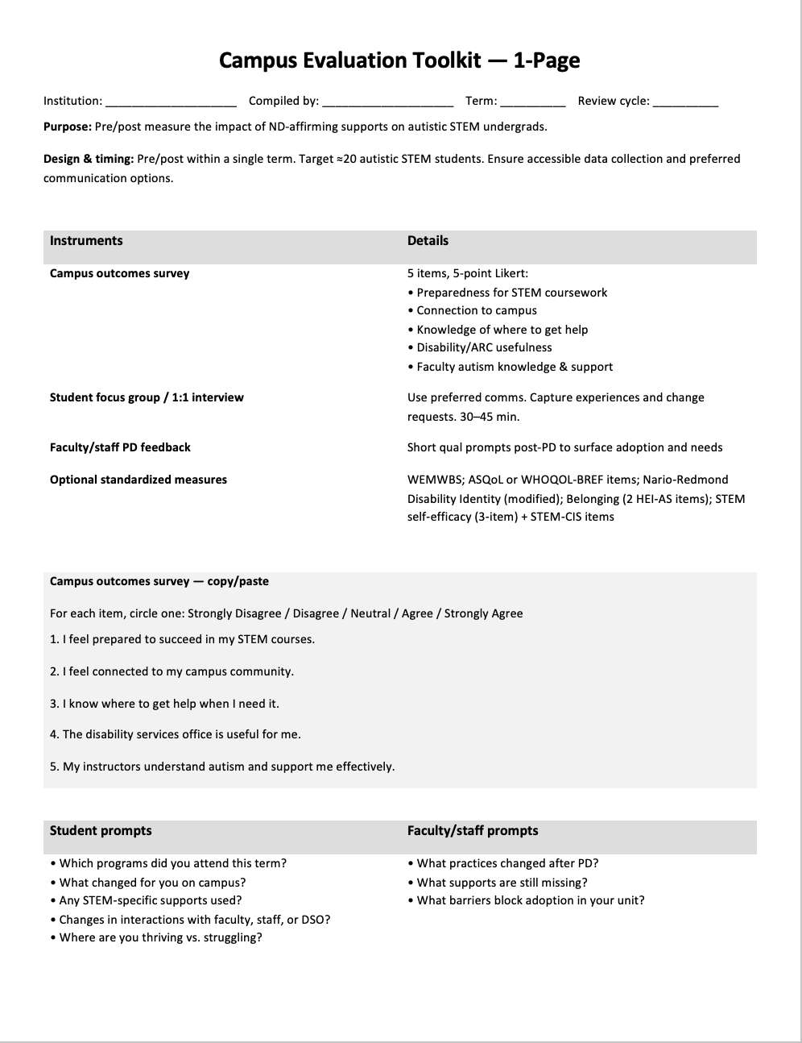
Planning worksheets

Slide 22
Acknowledgements and contact information
Dr. Ariana Arista is the Principal Investigator for NU, and she created many of the materials shown here today. She is out on maternity leave, and we really miss her!
NASA’s Neurodiversity Network materials are based upon work supported by NASA under award number 80NSSC21M0004 to Sonoma State University, working in partnership with the Education Development Center (EDC), the New York Hall of Science, and WestEd. Any opinions, findings, and conclusions or recommendations expressed in this material are those of the author(s) and do not necessarily reflect the views of the National Aeronautics and Space Administration.
Materials for Neurodiverse Undergraduates are based upon work supported by NSF IUSE under award number 2235658 to Education Development Center (EDC), working in partnership with Sonoma State University, CSU East Bay and CSU Chico. Any opinions, findings, and conclusions or recommendations expressed in this material are those of the author(s) and do not necessarily reflect the views of the NSF.
Contact information: For N3 and NU general inquiries, write to: edeon@sonoma.edu
Lynn Cominsky: lynnc@universe.sonoma.edu
A. Josephine Blagrave: ablagrave@csuchico.edu
Shubha Kashinath: shubha.kashinath@csueastbay.edu

